Slide 1
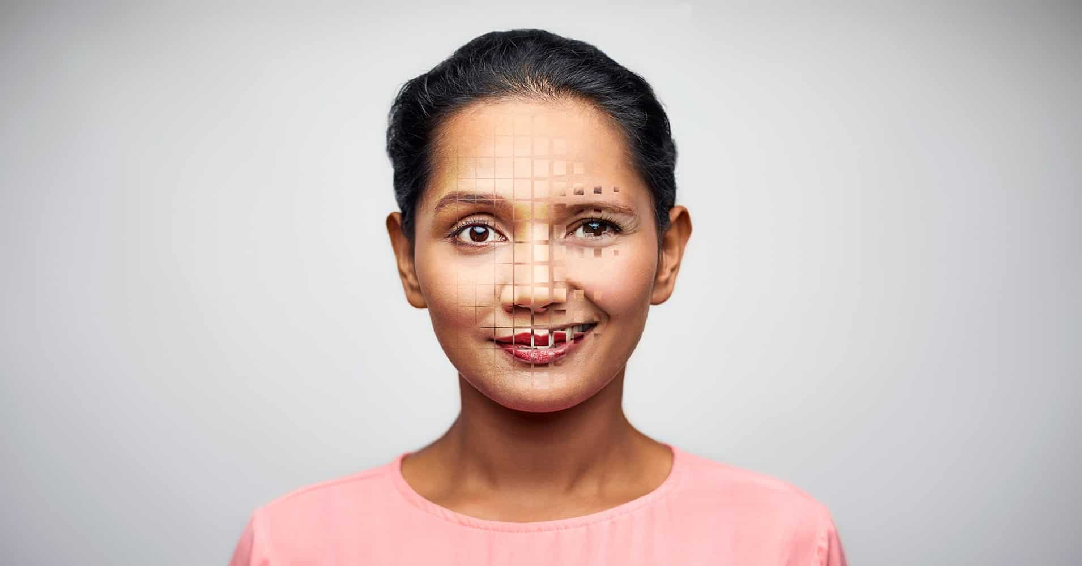

Detecting AI-Altered Media with Deep Learning
Advisor
Dr. Arnab Bose
Presented By
Rhys Chua
Jim Fang
Jon Huff
Notes:
Good morning everyone, today we'd like to showcase some of the findings of our independent research project on Detecting AI-Altered Media with Deep Learning.
My name is Jim Fang, and I'm joined by my team members Jon Huff and Rhys Chua, advised by Dr. Arnab Bose.

Slide 2
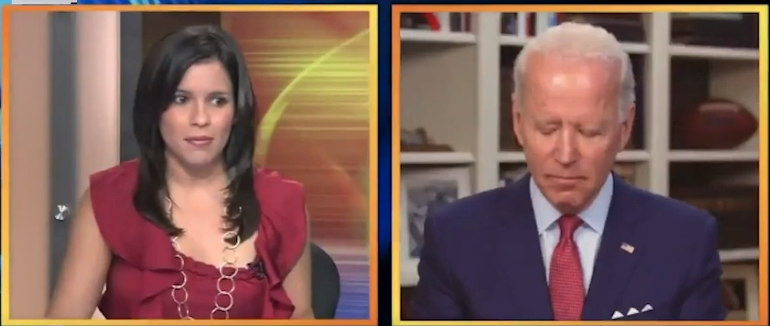
August 29th, 2020:
A digitally altered video of Joe Biden is uploaded onto Twitter & Youtube
Notes:
Before we dive in, I'd like to take us back to August 2020, in which a potentially damaging altered video of then presidential candidate Joe Biden was uploaded on the web.

Slide 3

Within the span of 24 hours...
The video received 2.4M views on Twitter...
Notes:
Within 24 hours, the video received 2.4M views on Twitter,

Slide 4

Within the span of 24 hours...
The video received 2.4M views on Twitter...
200K+ views on YouTube...
Notes:
over 200K views on YouTube,

Slide 5

Within the span of 24 hours...
The video received 2.4M views on Twitter...
200K+ views on YouTube...
Shared tens of thousands of times on Facebook...
Notes:
and shared countless times on Facebook.

Slide 6
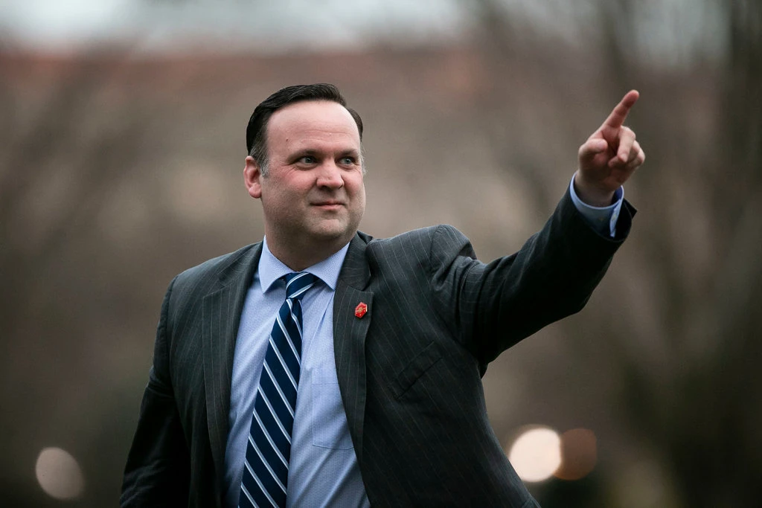
Within the span of 24 hours...
The video received 2.4M views on Twitter...
200K+ views on YouTube...
Shared tens of thousands of times on Facebook...
...And gets retweeted by the White House Deputy Chief of Staff & Director of Social Media, Dan Scanvino, which was then seen by millions more
Notes:
Perhaps most alarming was that it was retweeted by the White House Director of Social Media, exposing it to millions more.

Slide 7
Deepfakes are roughly doubling every 6 months
276k
154k
85k
49k
24k
15k
8k
Dec ‘18
Jun ‘19
Dec ‘19
Jun ‘20
Dec ‘20
Jun ‘21 Projected
Dec ‘21 Projected
Notes:
This was not an isolated event - we are living in a time of unprecedented growth of deepfakes, with the number doubling every 6 months.

Slide 8
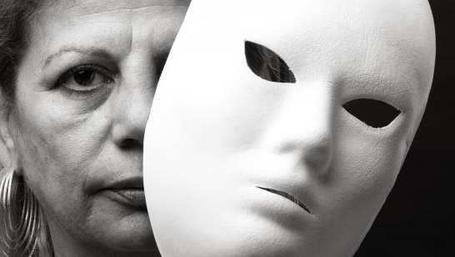
Every minute,​
16 IDENTITIES
will be stolen ​ and repurposed.​
Notes:
We estimate 16 identities will be stolen EVERY single MINUTE in the coming months.

Slide 9


The Public senses a looming threat...
63%
of U.S. adults surveyed believe altered videos create a great deal of confusion about the facts of current events
$68M
77%
of U.S. adults surveyed support restrictions on publishing and accessing them
Notes:
The public senses the looming threat, with 77% in support of restrictions on the creation of deepfakes

Slide 10
...and the U.S. Government Agrees
63%
of U.S. adults surveyed believe altered videos create a great deal of confusion about the facts of current events
$68M
77%
of U.S. adults surveyed support restrictions on publishing and accessing them
Spent by DARPA to research ways to fight threat of deepfakes
in 2016-2018
Notes:
and the U.S. government spending $68M to research ways to battle this.

Slide 11

How do we combat the threat of misinformation?
Notes:
We estimate 16 identities will be stolen EVERY single MINUTE in the coming months.

Slide 12
The Solution
Build a deep learning pipeline to distinguish
Fake, AI-altered videos from real videos
using Deep Ensemble Learning
Notes:
The solution that we propose today is to build a deep learning pipeline to distinguish fake, AI altered videos from real videos using Deep Ensemble Learning.

Slide 13


Visual
Audio
Notes:
When it comes down to it, AI Altered Videos can fall into one of two categories. Visual or Audio –

Slide 14
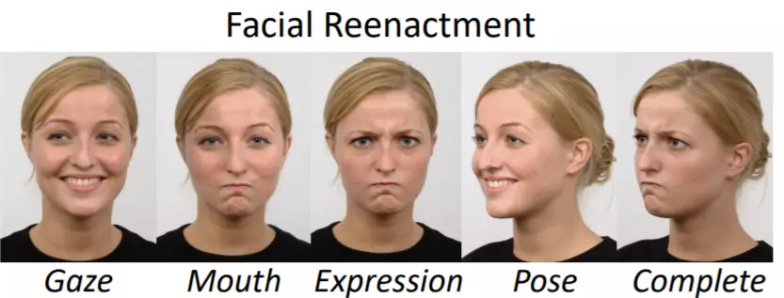
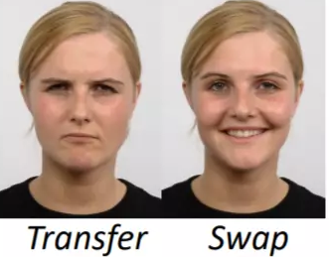
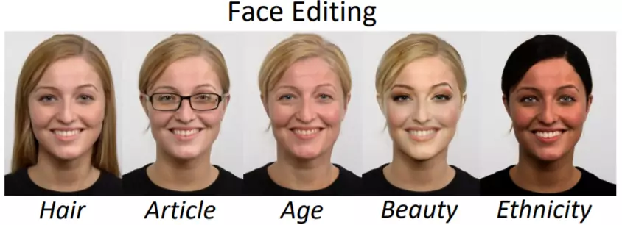
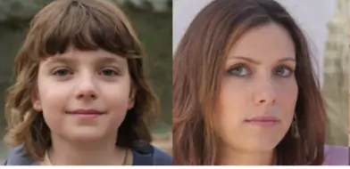
Face Reenactment
Visual
Face Replacement
Face Editing
Face Synthesis
Audio
Speech Synthesis (Concatenative, Parametric, and Deep Learning)
Notes:
with Visual breaking out into the following categories
and Audio focused on Speech Synthesis.

Slide 15
Face Reenactment
Visual
Face Replacement
Face Editing
Face Synthesis
Audio
Speech Synthesis (Concatenative, Parametric, and Deep Learning)
Notes:
For our project, we focused on the former.

Slide 16



Goals of this Project
Build a deep learning pipeline to distinguish fake from real videos
Contribute something new to the research community AND deliver a best-in-class deepfake detector that stands up to the current SoTA on the latest datasets
Publish a working app + code that can detect deepfakes in real-time as a contribution to the research community & for commercial use

Slide 17
Contributions
 | Tolosana Et Al. (2020) | 1st Place DFDC Winner | Dessa (2019) | Wang Et Al. (2020) | Our Method
Utilizes CNN’s and image preprocessing techniques (augmentation, cropping) | ✅ | ✅ | ✅ | ✅ | ✅
Trained on datasets that use Face2Face, FaceSwap, Deepfake, and NeuralTextures techs. | ✅ | ✅ | ✅ | ✅ | ✅
Transfer Learning using Xception | ✅ |  | ✅ | ✅ | ✅
Transfer Learning using Efficientnet |  | ✅ |  |  | ✅
Trained on Mixed Datasets for greater generalizability |  |  | ✅ |  | ✅
Transfer Learning using 3D CNN’s |  |  |  | ✅
Utilizes LSTM to process sequences of frames |  |  |  |  | ✅
Notes:
In the next few minutes, you will see that not only have we incorporated the latest techniques in our detector,

Slide 18

Contributions
 | Tolosana Et Al. (2020) | 1st Place DFDC Winner | Dessa (2019) | Wang Et Al. (2020) | Our Method
Utilizes CNN’s and image preprocessing techniques (augmentation, cropping) | ✅ | ✅ | ✅ | ✅ | ✅
Trained on datasets that use Face2Face, FaceSwap, Deepfake, and NeuralTextures techs. | ✅ | ✅ | ✅ | ✅ | ✅
Transfer Learning using Xception | ✅ |  | ✅ | ✅ | ✅
Transfer Learning using Efficientnet |  | ✅ |  |  | ✅
Trained on Mixed Datasets for greater generalizability |  |  | ✅ |  | ✅
Transfer Learning using 3D CNN’s |  |  |  | ✅
Utilizes LSTM to process sequences of frames |  |  |  |  | ✅
Ability to detect multiple subjects per frame |  |  |  |  | ✅
Uses Ensemble Meta-learner that increases performance and allows plug/play new models |  |  |  |  | ✅
Developed a functional app with built-in model interpretability algorithms |  |  |  |  | ✅
Notes:
but we've also added the ability to detect multiple subjects per frame and introduced the use of a ensemble metalearner, and perhaps most importantly built a functional app with built-in model interpretability that researchers can use.
Now that you have a better idea of the problem at hand and what to expect, I'll pass it to Rhys who will speak to how we tackled the problem itself.

Slide 19
Implementation
Notes:
Build a deep learning pipeline to perform binary classification of AI altered videos to determine whether they are Fake or Not Fake
Stretch: Improve upon current SoTA technqiues and create a prototype app for academic/commercial use

Slide 20



Pipeline Overview
Data Collection
Collect Deepfake Datasets
Notes:
We started off by collecting deep fake datasets using google drive as storage.

Slide 21



Pipeline Overview
Data Collection
Pre-processing
Collect Deepfake Datasets
Extract frames
Crop Faces
Split into Train, Valid, Test Sets, Isolate Actors
Notes:
Followed by pre-processing videos, where we focused on extracting video frames, cropping out faces, splitting datasets into train, validation, and test.

Slide 22


Pipeline Overview
Data Collection
Pre-processing
Model Training
Collect Deepfake Datasets
Extract frames
Crop Faces
Store in HDF5 files, upload to RCC
Perform Data Augmentation, Train Transfer Learning Models
Split into Train, Valid, Test Sets, Isolate Actors
Notes:
Next, we created a repository on RCC for data and model storage. We performed data augmentation, trained our models.

Slide 23


Pipeline Overview
Data Collection
Pre-processing
Model Training
Tuning
Collect Deepfake Datasets
Extract frames
Crop Faces
Store in HDF5 files, upload to RCC
Perform Data Augmentation, Train Transfer Learning Models
Observe Validation AUC, Score on Test Set
Split into Train, Valid, Test Sets, Isolate Actors
Adjust model hyperparameters and repeat
Notes:
Next, we observed validation AUC and score on our test sets, we adjusted model hyper parameters accordingly.

Slide 24


Pipeline Overview
Data Collection
Pre-processing
Model Training
Tuning
Deployment
Collect Deepfake Datasets
Extract frames
Crop Faces
Store in HDF5 files, upload to RCC
Perform Data Augmentation, Train Transfer Learning Models
Observe Validation AUC, Score on Test Set
Implement Champion Model
Deploy and Host on AWS
Split into Train, Valid, Test Sets, Isolate Actors
Adjust model hyperparameters and repeat
Notes:
And lastly, for visualization and deployment, a web application was built using streamlit. This will be eventually deployed and hosted on AWS.

Slide 25
Data Collection
Notes:
Build a deep learning pipeline to perform binary classification of AI altered videos to determine whether they are Fake or Not Fake
Stretch: Improve upon current SoTA technqiues and create a prototype app for academic/commercial use

Slide 26
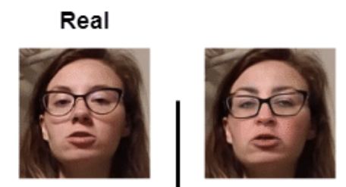
DeepFake Datasets
 | DFDC | FaceForensics++ | Celeb-DF | Mixed Dataset
Main Focus | Compilation of Diff Datasets | Different forgery methods | Reduce Visual Quality Gap | FF++ and CDF
Generation | 3rd | 2nd | 2nd | Created by Us
Size (# Videos) | 25TB (129K) | 39GB (5K) | 34GB (6K) | 280GB (8.4K)
Train/Val/Test % | 58/21/21 | 72/14/14 | 68/16/16 | 70/15/15
Real/Fake Ratio | 1:4.5 | 1:4 | 1:9 | 1:1
Method | Convolution Autoencoder | Generative Adversarial Network | Convolution Autoencoder | -
Technique | FaceSwap, Neural Talking Heads, Augmentation Techs | FaceSwap, Deepfakes, Face2Face, NeuralTextures | Increase resolution pixels, color transfer algorithm, face masking, temporal flickering | -
Fake
Independent Variables: Pixels from each frame of a sample video
Dependent Variables: Fake (1) vs Real (0) – Image Label
Unit of Analysis: 300x300pixel RGB image
Notes:
We utilized the celeb df and face forensics datasets in order to build our training models, while DFDC dataset was reserved for generalizability approaches. Each dataset serves a purpose to fine tune our detection methods.
For example DFDC which is a compilation of different datasets, was generated using convolutional auto encoder.
ffpp has 3 compression levels: raw, c23, c40.
everything was trained on c23 and then flickrfaces used 6 jpeg compression levels: raw, 80, 60, 40, 20, 10 (10 being highest compression/lowest quality)

Slide 27
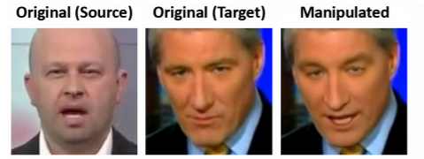
DeepFake Datasets
 | DFDC | FaceForensics++ | Celeb-DF | Mixed Dataset
Main Focus | Compilation of Diff Datasets | Different forgery methods | Reduce Visual Quality Gap | FF++ and CDF
Generation | 3rd | 2nd | 2nd | Created by Us
Size (# Videos) | 25TB (129K) | 39GB (5K) | 34GB (6K) | 280GB (8.4K)
Train/Val/Test % | 58/21/21 | 72/14/14 | 68/16/16 | 70/15/15
Real/Fake Ratio | 1:4.5 | 1:4 | 1:9 | 1:1
Method | Convolution Autoencoder | Generative Adversarial Network | Convolution Autoencoder | -
Technique | FaceSwap, Neural Talking Heads, Augmentation Techs | FaceSwap, Deepfakes, Face2Face, NeuralTextures | Increase resolution pixels, color transfer algorithm, face masking, temporal flickering | -
Independent Variables: Pixels from each frame of a sample video
Dependent Variables: Fake (1) vs Real (0) – Image Label
Unit of Analysis: 300x300pixel RGB image
Notes:
Face forensics which is a dataset that has been used extensively for our work, focuses on compression features, which was produced through generative adversarial network

Slide 28
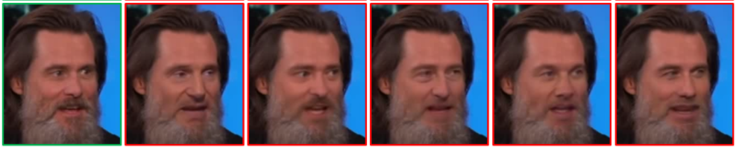
DeepFake Datasets
 | DFDC | FaceForensics++ | Celeb-DF | Mixed Dataset
Main Focus | Compilation of Diff Datasets | Different forgery methods | Reduce Visual Quality Gap | FF++ and CDF
Generation | 3rd | 2nd | 2nd | Created by Us
Size (# Videos) | 25TB (129K) | 39GB (5K) | 34GB (6K) | 280GB (8.4K)
Train/Val/Test % | 58/21/21 | 72/14/14 | 68/16/16 | 70/15/15
Real/Fake Ratio | 1:4.5 | 1:4 | 1:9 | 1:1
Method | Convolution Autoencoder | Generative Adversarial Network | Convolution Autoencoder | -
Technique | FaceSwap, Neural Talking Heads, Augmentation Techs | FaceSwap, Deepfakes, Face2Face, NeuralTextures | Increase resolution pixels, color transfer algorithm, face masking, temporal flickering | -
Real
Fake
Independent Variables: Pixels from each frame of a sample video
Dependent Variables: Fake (1) vs Real (0) – Image Label
Unit of Analysis: 300x300pixel RGB image
Notes:
Celeb df was curated in which the images have reduced visual quality gaps, it’s being generated using convolution auto encoder.

Slide 29
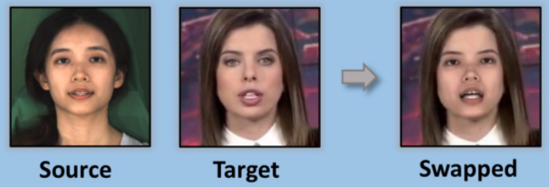
DeepFake Datasets
 | DFDC | FaceForensics++ | Celeb-DF | Mixed Dataset
Main Focus | Compilation of Diff Datasets | Different forgery methods | Reduce Visual Quality Gap | FF++ and CDF
Generation | 3rd | 2nd | 2nd | Created by Us
Size (# Videos) | 25TB (129K) | 39GB (5K) | 34GB (6K) | 280GB (8.4K)
Train/Val/Test % | 58/21/21 | 72/14/14 | 68/16/16 | 70/15/15
Real/Fake Ratio | 1:4.5 | 1:4 | 1:9 | 1:1
Method | Convolution Autoencoder | Generative Adversarial Network | Convolution Autoencoder | -
Technique | FaceSwap, Neural Talking Heads, Augmentation Techs | FaceSwap, Deepfakes, Face2Face, NeuralTextures | Increase resolution pixels, color transfer algorithm, face masking, temporal flickering | -
Independent Variables: Pixels from each frame of a sample video
Dependent Variables: Fake (1) vs Real (0) – Image Label
Unit of Analysis: 300x300pixel RGB image
Notes:
Lastly, we used a mixed dataset that comprised of face forensics and celeb df to provide more diversity to our datasets.
I’ll pass it on to Jon to talk about video processing

Slide 30
Video Processing
Notes:
Build a deep learning pipeline to perform binary classification of AI altered videos to determine whether they are Fake or Not Fake
Stretch: Improve upon current SoTA technqiues and create a prototype app for academic/commercial use

Slide 31
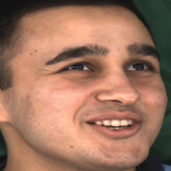
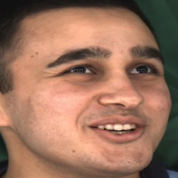
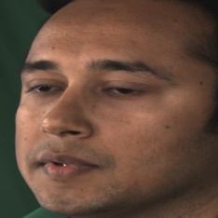
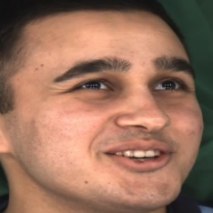
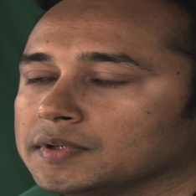
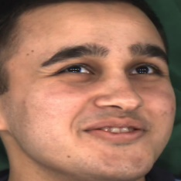
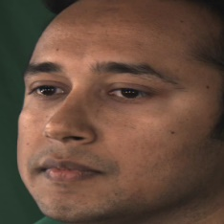
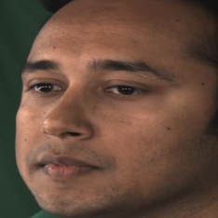
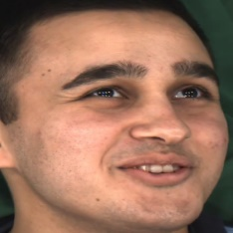
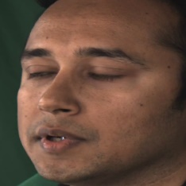
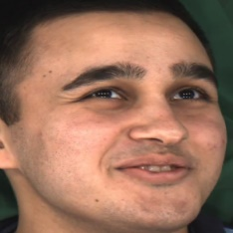
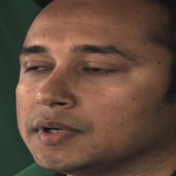
The Sorting Challenge
We propose to analyze sequences of still frame images in videos for deepfake detection
Naïve face detection algorithms do not automatically sort identities when multiple faces are detected in each frame. Mixed sequences of faces contaminate our datasets.
Frame 1
Frame 2
Frame 3
Frame 4
Frame 5
Frame 6
“Subject A”
“Subject B”
Frame 1
Frame 2
Frame 3
Frame 4
Frame 5
Frame 6
“Subject A”
“Subject B”
Notes:
The Challenge
We propose to analyze sequences of still frame images in videos to detect deepfake media. After gathering all the datasets, we immediately encountered an issue: face detection algorithms do not automatically sort identities when multiple faces are detected in each frame. These arbitrarily mixed datasets would indeed contaminate our model training.

Slide 32
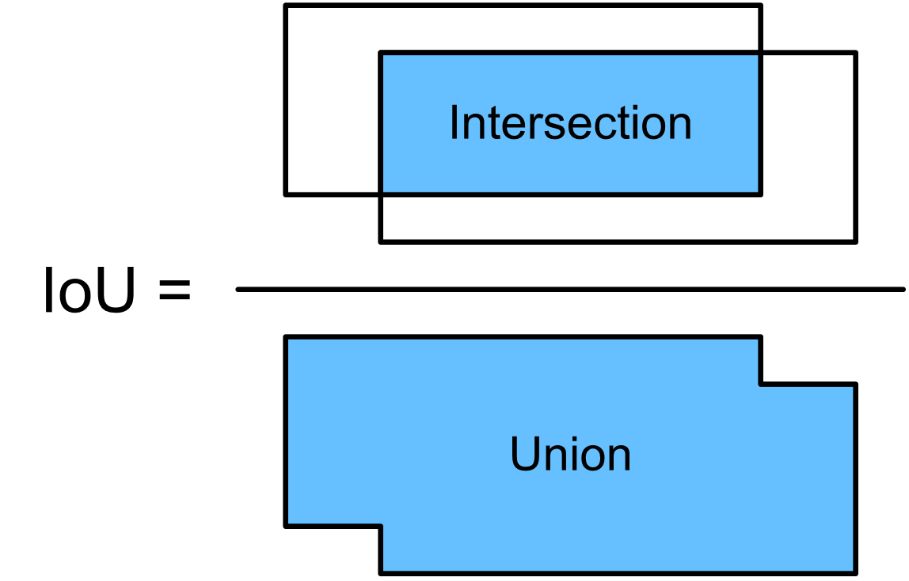
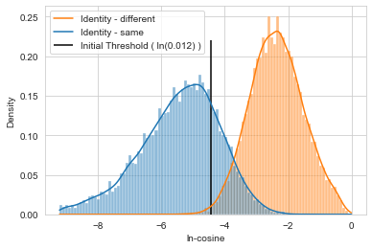
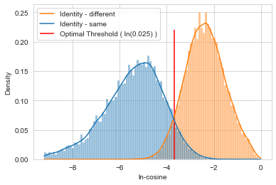
Solution: A Custom Face-Sorting Algorithm
To overcome the issue of contaminated sequences, we designed and implemented a high-performance sorting algorithm which isolates sequences of faces based on:
1)
Sequential bounding box intersection-over-union threshold (IoU); the frames around detected faces must overlap frame-to-frame to be considered the same person
2)
Cosine distance of facial embeddings for multiple faces derived from FaceNet
The algorithm builds sequences by iteratively relaxing the cosine distance threshold up to a statistically determined value
+
Notes:
Clean Data
To overcome this issue of contamination, we built a custom high performance sorting algorithm compiled to machine code. The algorithm follows two primary steps: First, it isolates sequences that do not possess overlapping bounding boxes, or the square frames around detected faces. Second, it analyzes the similarity of faces using the FaceNet algorithm to determine whether the identity from one frame to the next remains the same. This algorithm allowed us to curate very clean datasets.

Slide 33

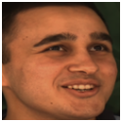
Data Transformations
Original Image
Models are prone to overfitting by memorizing faces
To combat this, we can employ a series of random transformations
Random Horizontal Flip
Random Rotation/Scaling
Random Brightness, Contrast, Saturation Jitter, Pixelation
Notes:
Our elementary classification models performed very poorly at first without any data transformations. However, upon performing random transformations at train time, performance increased dramatically.

Slide 34



Dataset Splits
To prevent overfitting and data leakage, face identities were strictly isolated to each of the train, validation, and test datasets
Train
Validation
Test
Notes:
To prevent overfitting and data leakage, face identities were isolated to each of the train validation and test datasets

Slide 35
Detection System
(Training + Tuning)
Notes:
Build a deep learning pipeline to perform binary classification of AI altered videos to determine whether they are Fake or Not Fake
Stretch: Improve upon current SoTA technqiues and create a prototype app for academic/commercial use

Slide 36
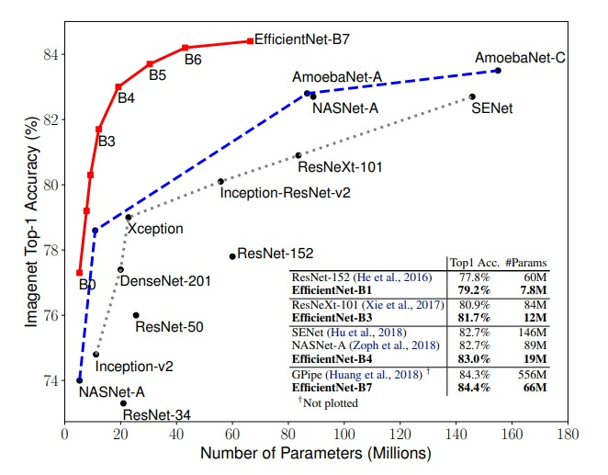
Model Selection (results below based on ImageNet)
EfficientNet: For our training process, Effnet-B4 provides the best balance of speed and accuracy, uniformly scales all dimensions of depth, width, & resolution using a compound coefficient​
XceptionNet:
Favored by researchers, introduced CNN based entirely on depthwise separable convolution layers
Notes:
Our model selection starts by comparing the performance of different architectures on the ImageNet benchmark dataset. From conducting research, we found Xception to be a widely utilized deep learning image classifier for deepfake detection. We also discovered the EfficientNet family of networks, and decided to focus on the B4 variant due to its combination of high performance and modest compute cost.

Slide 37
Initially considered but fell out of favor during model iteration due to substandard performance
Notes:
While we considered other architectures, they either did not perform as well or simply required too much compute.

Slide 38
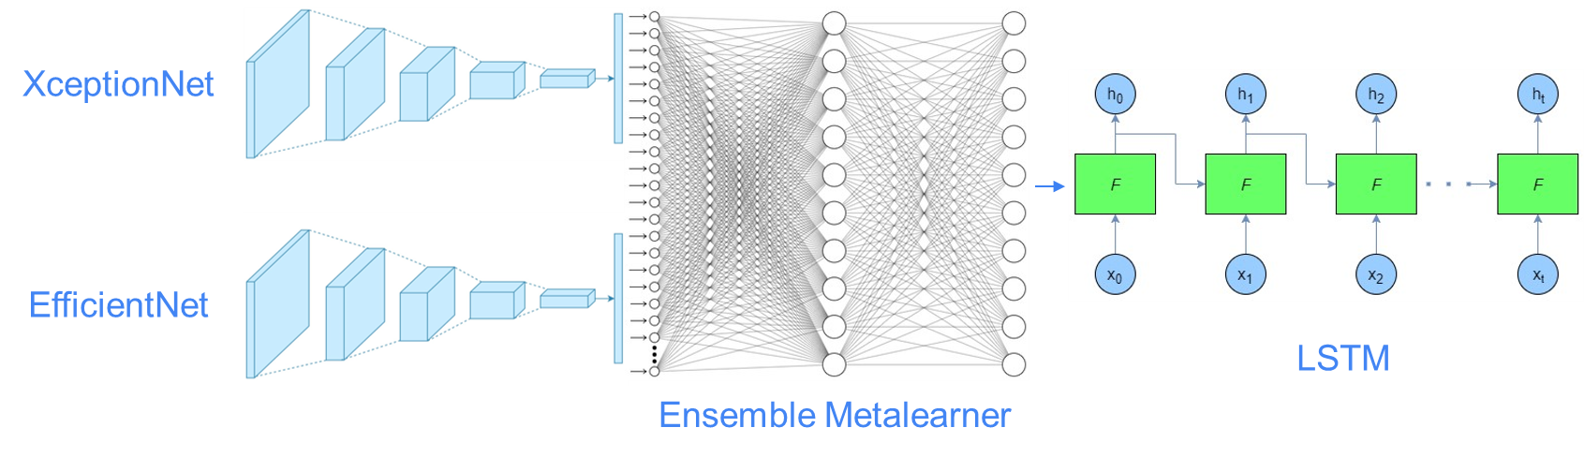
Our Novel Architecture
The Solution
Model Assumptions
Ensembles provide better predictive power
Sequence classification will add robustness
May not generalize well to unseen forgery methods
Notes:
This is a high level diagram of our proposed architecture. We ensemble Xception and EfficientNet modules with a trained meta-learner, and feed those output vectors into an LSTM to capture temporal features.

Slide 39
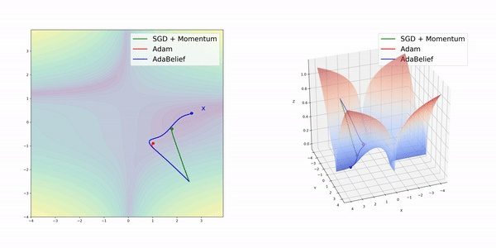
Model Training & Tuning
Image Classifiers
Meta-Learner
LSTM
XceptionNet and EfficientNet (b4)
All layers unfrozen
AdaBelief optimizer
Weight decay added
Fully custom multithreaded streaming data loader
Xception and EfficientNet fully trained and frozen
Classifier final layers replaced with trainable dense layers
Outputs fed into ensemble meta-learner
Meta-learner trained using same hyperparameters as the classifiers
Analyzes a sequence of outputs from the meta-learner
Training hyperparameters remained unchanged
Classifies each 30-frame sequence as “real” or “fake”
Model probabilities calibrated using temperature scaling
Notes:
Beginning with Image classifiers, we used XceptionNet and EfficientNet pretrained on the ImageNet dataset. All layers except the bottom of both networks were unfrozen in an attempt to allow the model to learn salient deepfake features without overfitting to the training data. AdaBelief, a novel optimizer, was used which showed marked performance over Adam. Weight regularization was added to prevent overfitting. Finally, images were loaded into memory with a fully custom multithreaded streaming data loader. The meta-learner contained the trained and fully frozen xception and efficientnet models with their final classification layers removed. These layers were replaced with trainable dense layers to standardize feature extraction vectors to 512-dimension. They were then fed into the meta-learner consisting of two dense layers of 1024 neurons in each layer. The LSTM model consisted of one hidden layer with 1024 neurons. The hyperparameters remained the same except for changing AdaBelief prameters for LSTM models according to the author. It classified 30 frame sequences as either real or fake. The output probabilities were calibrated using temperature scaling.

Slide 40
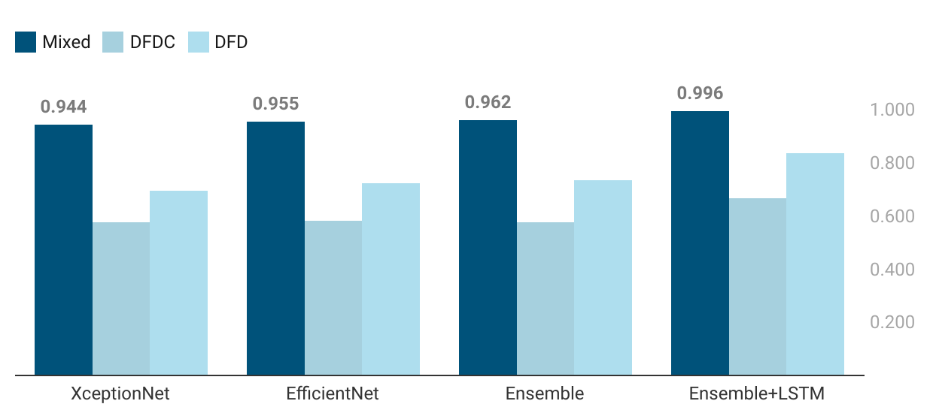
AUC for In-Distribution Test Sets
Precision | 0.982
Recall | 0.963
F1 | 0.972
Predicted
 | Fake | Real
Fake | TP 4125 (0.98) | FN 75 (.02)
Real | FP 157 (0.04) | TN 4043 (0.96)
Actual
(Xception+EfficientNet)
(Xception + EfficientNet + LSTM)
Mixed: (Train/Test/Validation, in-distribution) Dataset comprised of randomly sampled videos from curated Celeb-DF and FF++ full datasets (Deepfakes, Face2Face, FaceSwap, FaceShifter, Neural Textures)
DFDC: (Holdout, out-of-distribution) Deepfake Detection Challenge, random sample from full dataset
DFD: (Holdout, out-of-distribution) FF++ Deepfake Detection; curated full dataset (original new actors different from FF++, not YouTube videos)
Notes:
We iteratively built upon each model, increasing our performance at each step until we were satisfied with the Ensemble+LSTM model on our mixed dataset. When tested on unseen data sourced from the same datasets on which the models were trained, the model exhibited very strong performance, achieving an AUC score over 99.

Slide 41
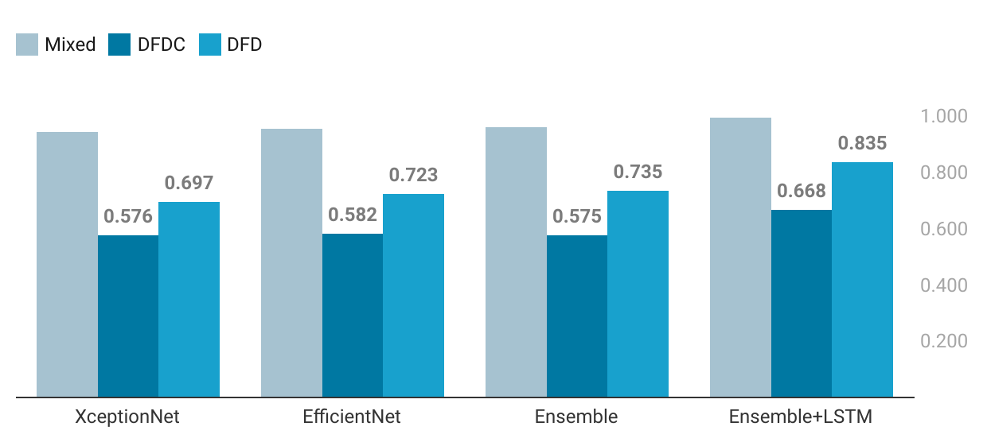
AUC for Out-of-Distribution Data
Precision | 0.588
Recall | 0.869
F1 | 0.701
Predicted
 | Fake | Real
Fake | TP 2693 (0.87) | FN 407 (.13)
Real | FP 1887 (0.46) | TN 2248 (0.54)
Actual
(Xception+EfficientNet)
(Xception + EfficientNet + LSTM)
Mixed: (Train/Test/Validation, in-distribution) Dataset comprised of randomly sampled videos from curated Celeb-DF and FF++ full datasets (Deepfakes, Face2Face, FaceSwap, FaceShifter, Neural Textures)
DFDC: (Holdout, out-of-distribution) Deepfake Detection Challenge, random sample from full dataset
DFD: (Holdout, out-of-distribution) FF++ Deepfake Detection; curated full dataset (original new actors different from FF++, not YouTube videos)
Notes:
To investigate how well our model would perform on in-the-wild deepfakes, we tested performance on two datasets that the model had never seen: Deepfake Detection and Deepfake Detection Challenge. Due to the inferior quality of the DFDC dataset, we focused solely on DFD for our analysis. As you can see, the performance dropped significantly. Notably, the false positive rate as listed in the upper right table was .46, meaning that for all the real videos, the model misclassified nearly half of them as fake. We understood this to mean that quality of the real videos in DFD was significantly different from the quality of the real videos in our training data. That is, our authentic video training data was not varied enough in quality.

Slide 42
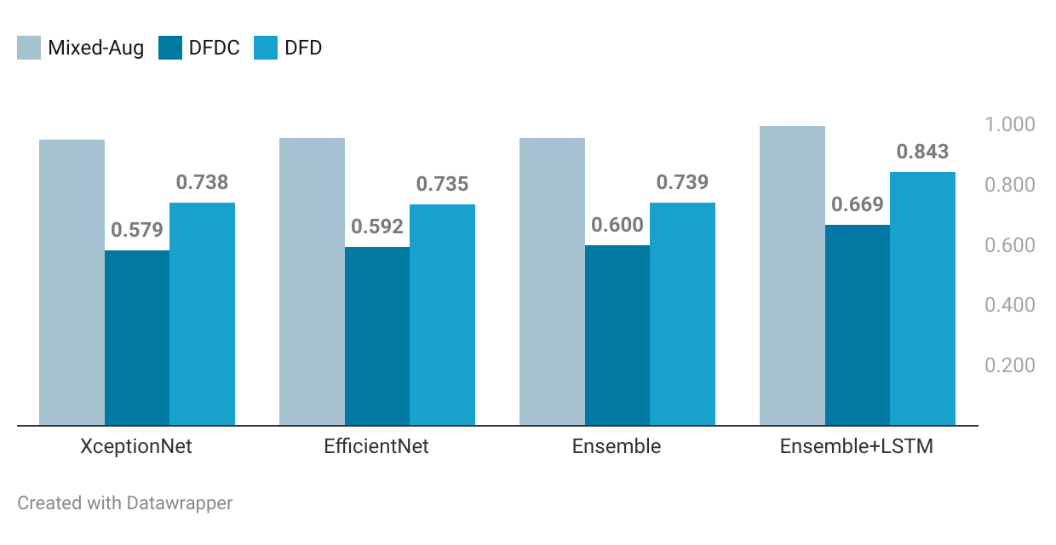
After
With Augmented Data (Flickrfaces + Addl. Transformation – 2x train/val/test)
Before
Precision | 0.588
Recall | 0.869
F1 | 0.701
Precision | 0.651
Recall | 0.848
F1 | 0.736
Predicted
 | Fake | Real
Fake | TP 2629 (0.85) | FN 471 (.15)
Real | FP 1408 (0.34) | TN 2727 (0.66)
Actual
(Xception+EfficientNet)
(Xception + EfficientNet + LSTM)
Mixed: (Train/Test/Validation, in-distribution) Dataset comprised of randomly sampled videos from curated Celeb-DF and FF++ full datasets (Deepfakes, Face2Face, FaceSwap, FaceShifter, Neural Textures)
DFDC: (Holdout, out-of-distribution) Deepfake Detection Challenge, random sample from full dataset
DFD: (Holdout, out-of-distribution) FF++ Deepfake Detection; curated full dataset (original new actors different from FF++, not YouTube videos)
Notes:
To combat this, we combined our mixed dataset with high quality real face images from a dataset called FlickrFaces. We generated 6 versions of the FlickrFaces dataset, all varying in image compression levels ranging from quality 100 to quality 10. To reiterate, no new deepfakes were introduced. While AUC only increased slightly, precision increased from .59 to .65 at the expense of a slight decrease in recall, and our false positive rate decreased from .46 to .34.

Slide 43
Comparison to SoTA Detectors on OOD Datasets
The Solution
 | Test Set | OOD | AUC
Tolosana et al (2020) | CDF |  | 0.999
Oscar et al (2020) | CDF |  | 0.997
Ours (ID) | Mixed |  | 0.996
Ours (OOD) | DFD | ✅ | 0.843
Lingzhi et al (2020) | CDF | ✅ | 0.806
Yuval et al (2020) | CDF | ✅ | 0.660
Dessa (2019) | FF++ | ✅ | 0.630
Notes:
While we cannot make true comparisons to other implementations that considered out-of-distribution data, our model performed competitively on both in-distribution and out-of-distribution data, given the datasets on which it was trained.
I will now hand off to Jim for a discussion on model interpretability.

Slide 44
Model Interpretability
Notes:
Build a deep learning pipeline to perform binary classification of AI altered videos to determine whether they are Fake or Not Fake
Stretch: Improve upon current SoTA technqiues and create a prototype app for academic/commercial use

Slide 45
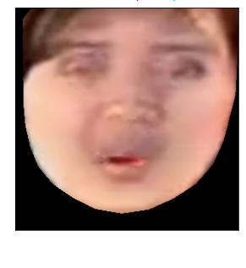
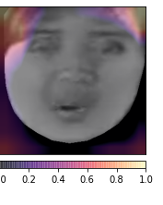
True Positive (Fake Image – Easy Detection)
The Solution
Original Image | GradCAM
Predicted Probability: 1.0
Brighter region = more positive contribution to final prediction
(steeper gradient to final conv. layer)
Notes:
To interpret our models, we leveraged GradCAM to help us understand which regions of a face contribute most to a prediction of fake or real, shown by the brightest spots.

Slide 46
True Positive (Fake Image – Easy Detection)
The Solution
Original Image | GradCAM
Predicted Probability: 1.0
Our detector easily discerns this poorly rendered deepfake (lighting differences)
GradCAM, a model interpretability algorithm, reveals the facial regions that are most positively attributed to the prediction of “Fake”
Notes:
As we see here, our detector does a great job of identifying the blending artifacts created by Face2Face around the outside edges.

Slide 47
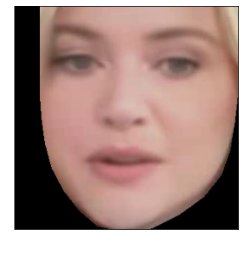
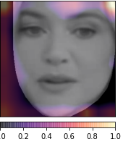
True Positive (Fake Image – Difficult Detection)
The Solution
Original Image | GradCAM
Predicted Probability: 1.0
Here, the difference is less easily discerned, but our model is just as confident
We expect artifacts/latent features to occur around the chin and forehead region due to the techniques mentioned in Face2Face’s paper, which is confirmed by GradCAM
Predicted Probability via EfficientNet Model: 1.0
Notes:
Here, we see the same thing on a better blended image.

Slide 48
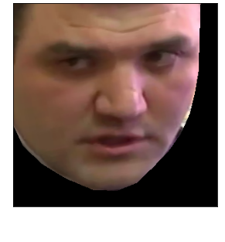
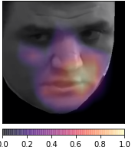
True Negative (Real Image)
The Solution
Original Image | GradCAM
Predicted Probability: 1.0
Predicted Probability via EfficientNet Model: 1.0
Notes:
Here, we see an example of a True Negative, and from what we've seen quite consistently the model seems to focus on the nose and mouth which make sense given that is where most of the movement occurs in a video.

Slide 49
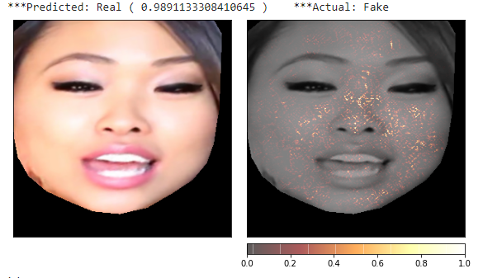
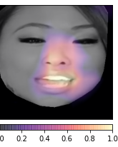
False Negative (Fake Image)
The Solution
Original Image | GradCAM
Predicted Probability: 0.99
Here, the model is extremely confident that this is a real image, however it is wrong
Our model potentially placed too much weight on this region or was tricked by expert blending for this frame
Needs to be tuned to better identify artifacts such as this
Predicted Probability via EfficientNet Model: 1.0
Notes:
But the next two are the most interesting - here we failed to detect a fake image and could have done a better job noticing the artifact around the outside edge of the face.

Slide 50
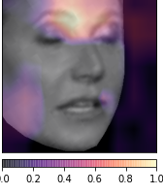
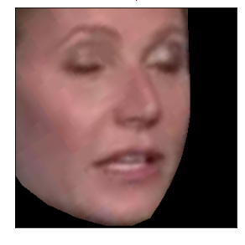
False Positive (Real Image)
The Solution
Original Image | GradCAM
Predicted Probability: 1.0
The model gets confused here and labels a real image as fake
GradCAM tells us that the upper browline + upper left lip appeared similar to previously trained fake frames, potentially due to poor image quality or some naturally occurring blemish caused by movment
Predicted Probability via EfficientNet Model: 1.0
Notes:
Here we failed to detect a real image by focusing too much on the outside edge which could have turned out to be a natural blur or low-res part of the video.

Slide 51
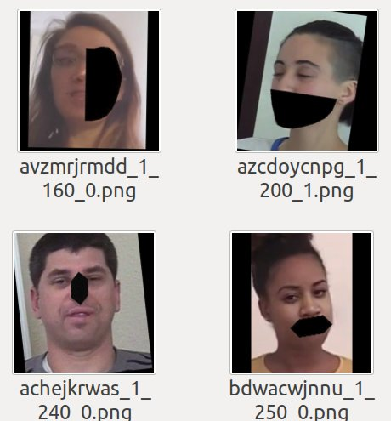
Future Improvements Based on GradCAM
Blackout random regions of the face
Focus on conv layers that address outer edges of face
3) Augment dataset with more images that have that type of artifact/blemish
Notes:
As you have seen, these findings illuminate where our detector falters. We can find examples of frames where we perform the worst and augment our dataset with images of faces with these regions blacked out for better performance.
I'll now pass it back to Jon who will discuss the deployment of our model and provide a demo.

Slide 52
Deployment (Detection Web App)

Slide 53

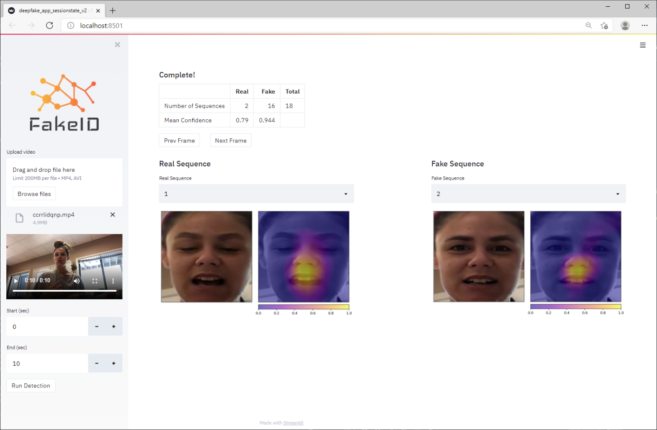

3
1
Powered by
4
User uploads and selects a subset of a video
Video is parsed and still frames propagate through the pipeline
The app then displays basic classification results
GradCAM interpretability algorithm results are displayed
Notes:
We introduce our deepfake detection app, FakeID built on the Streamlit platform. This app requires two simple steps by the user: upload a video and select a subset for analysis. The video is parsed and still frames propagate through the pipeline. The app then displays basic classification results. The GradCam interpretability algorithm results are then displayed.

Slide 54
Demo
Notes:
Now we will see the app perform a live deepfake detection.

Slide 55
Addressing Generalizability
Notes:
At this point, we

Slide 56

If generation/detection are in an arms race, how do we detect forgery methods we’ve never seen?
This has yet to be solved by anyone!
Notes:
As we saw previously, our results were strong, but clearly not without flaw. Generalizability is essentially the Achilles heel of deepfake detection. It stands as an unsolved problem which few researchers have openly addressed; how do we detect forgery methods we’ve never seen?

Slide 57
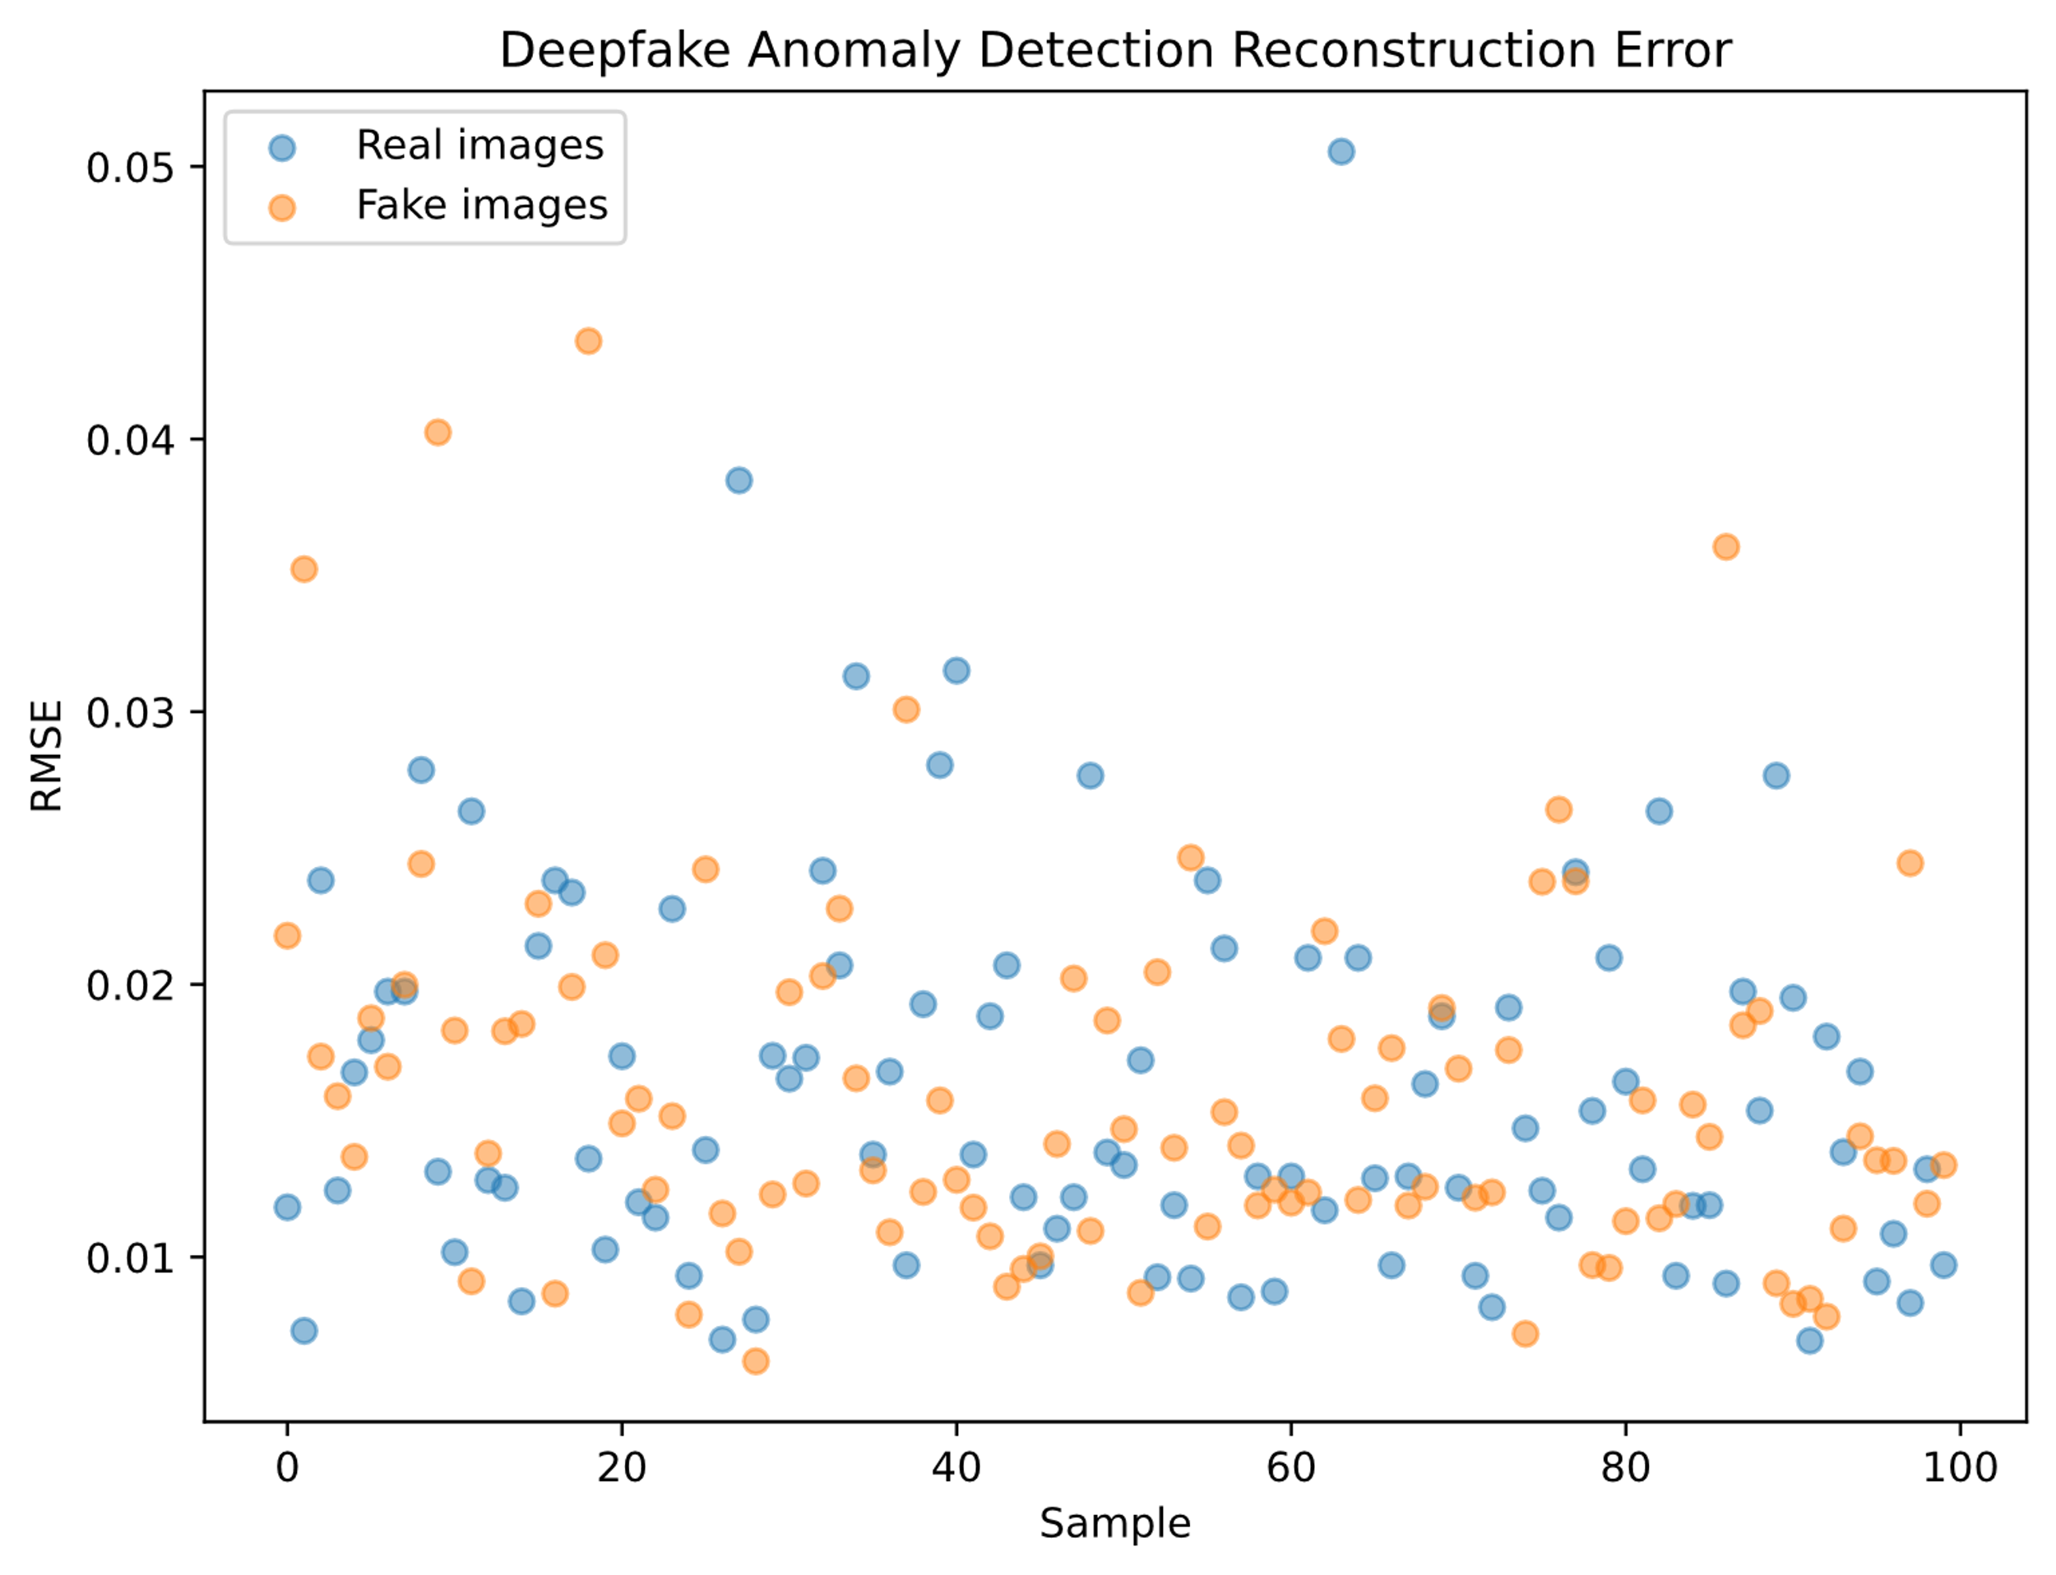
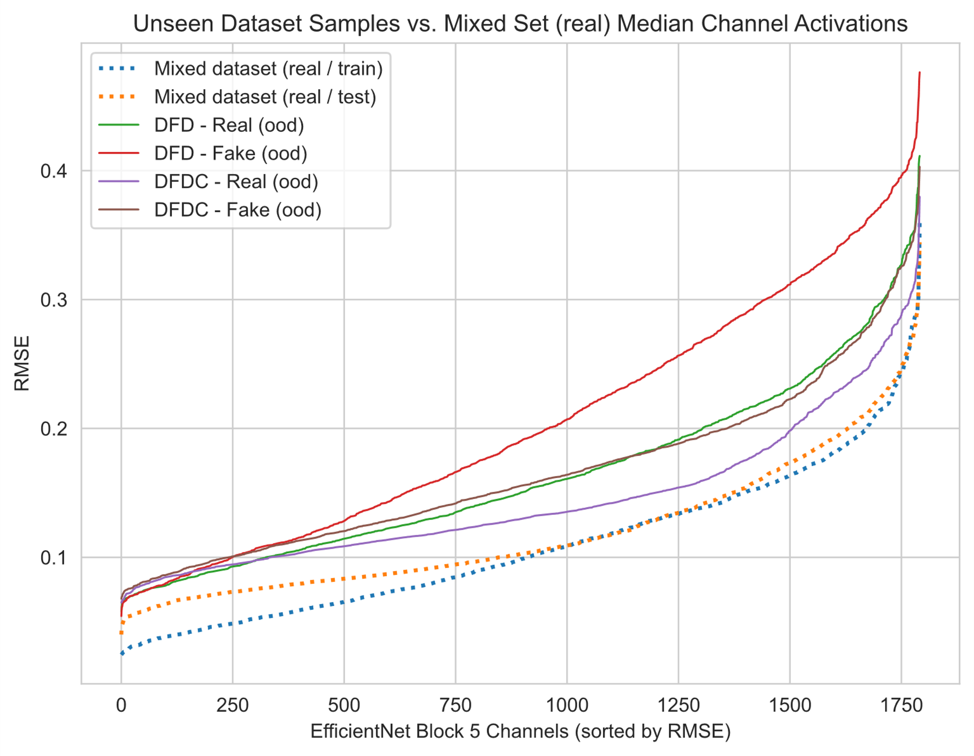
Two Approaches
Image outlier detection: We know what authentic video frames look like, flag videos that do not conform
Neural activation analysis: Model misclassifications on never-before-seen forgery methods may be identified by investigating the inner workings of our detection model
Notes:
We attempt to tackle this two ways. First, utilize autoencoder anomaly detection; we know what authentic video frames look like, thus we can flag videos that do not conform to this standard. Second, assess neural activations in our image classifiers. We approached the first method using a convolutional autoencoder with varying model architectures and levels of dimensionality reduction. However, as we can see in the left chart, image reconstruction yields no separation between real and fake videos. Likewise, while we did see some degree of success by analyzing the features within our model, the green and brown middle lines portray a near perfect overlay of real and fake videos, rendering this effort inconclusive and therefore was omitted from our solution.

Slide 58
Final Thoughts and Future Work

Slide 59
Contributions
 | Tolosana Et Al. (2020) | 1st Place DFDC Winner | Dessa (2019) | Wang Et Al. (2020) | Our Method
Utilizes CNN’s and image preprocessing techniques (augmentation, cropping) | ✅ | ✅ | ✅ | ✅ | ✅
Trained on datasets that use Face2Face, FaceSwap, Deepfake, and NeuralTextures techs. | ✅ | ✅ | ✅ | ✅ | ✅
Transfer Learning using Xception | ✅ |  | ✅ | ✅ | ✅
Transfer Learning using Efficientnet |  | ✅ |  |  | ✅
Trained on Mixed Datasets for greater generalizability |  |  | ✅ |  | ✅
Transfer Learning using 3D CNN’s |  |  |  | ✅
Utilizes LSTM to process sequences of frames |  |  |  |  | ✅
Ability to detect multiple subjects per frame |  |  |  |  | ✅
Uses Ensemble Meta-learner that increases performance and allows plug/play new models |  |  |  |  | ✅
Developed a functional app with built-in model interpretability algorithms |  |  |  |  | ✅
Notes:
Throughout today, we've seen the power of combining an Ensemble Metalearner with LSTM to achieve high AUC on OOD videos, comparable to the SOTA. We did this by first overcoming sorting challenges with an entirely new algorithm, while also adding model interpretability with GradCAM. We topped this off with FakeID, an all-in-one app solution that we plan to release to the public. All of these combined present a unique solution that we feel is a noteworthy contribution to academia or deployed for commercial use.

Slide 60






Future Work
Improve on Deep Learning Models
Additional Datasets for Diversification
Demographics
Race
Age
Deeper Forensics
Full face swapping
Additional data augmentation
Online Deep Learning
Increase data availability for model training
Improve on Deep Learning Models
3D CNN
Capture spatio-temporal features
Siamese Network
Distinguishes unique facial features
Optical Flow
Granular pixel-to-pixel prediction
Additional Datasets for Diversification
Notes:
Future works could include training models using other deep learning techniques such as 3d CNN to capture spatio-temporal features in videos. Siamese network which is used in image recognition systems to distinguish unique facial features. And Optical flow for granular pixel to pixel prediction.
Additional datasets could improve on detection methods too. Datasets with diverse demographics would help deep learning models to pick up facial images with different skin tones and age variations. Second to that, the deeper forensics dataset would be beneficial too, as it contains videos with full face swapping. Lastly , online deep learning technique could be used to help optimize model training as it allows models to be trained on the fly whenever data is available.
That concludes our presentation, thanks for listening.
(All covered by low to mid level code modifications)1) user-uploaded models/weights2) research online learning potential for new datasets3) crowd-sourcing while considering adversarial attack threats
Add mention of releasing back to community as package
Enable crowd-sourcing to improve model
Adversarial Attacks

Slide 61
Thank you!
Notes:
Build a deep learning pipeline to perform binary classification of AI altered videos to determine whether they are Fake or Not Fake
Stretch: Improve upon current SoTA technqiues and create a prototype app for academic/commercial use

Slide 62
Appendix
Notes:
Build a deep learning pipeline to perform binary classification of AI altered videos to determine whether they are Fake or Not Fake
Stretch: Improve upon current SoTA technqiues and create a prototype app for academic/commercial use

Slide 63
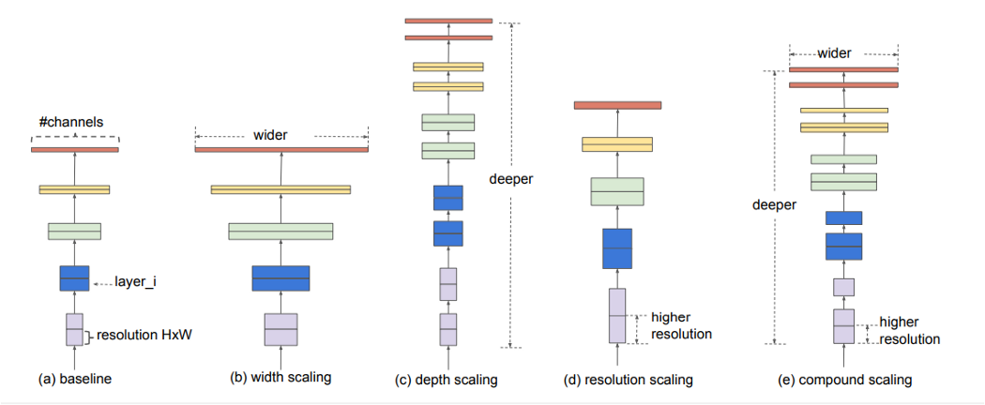
Value of EfficientNet

Slide 64
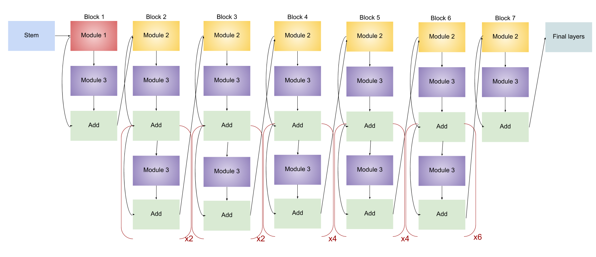
Efficient-B4

Slide 65

Model Comparison

Slide 66
Model Comparison
 | XceptionNet | EfficientNet | InceptionNetV3 | ResNet50 | ResNeSt200
Overview | An extension of the Inception architecture which replaces the standard Inception modules with depthwise separable convolutions | Uniformly scales all dimensions of depth/width/resolution using a compound coefficient​ | Inception module is to act as a “multi-level feature extractor” | A form of “exotic architecture” that relies on micro-architecture modules | A variant of ResNet. Stacks Split-Attention blocks that can distribute attention to several feature-map groups
Capabilities | Introduced CNN based entirely on depthwise separable convolution layers | Uniformly scales all dimensions of depth/width/resolution using a compound coefficient​ | Building networks using modules/blocks. Instead of stacking convolutional layers, we stack modules or blocks, within which are convolutional layers | Designing even deeper CNNs (up to 152 layers) without compromising model’s generalization power. Among the first to use batch normalisation | Maintains overall structure of ResNet and can be used directly for downstream, tasks without adding additional computational effort
Parameters | ~22 million | ~11 million | ~23 million | ~25 milion | ~70 milion
Top-1 Accuracy | 0.79 | 0.84 | 0.78 | 0.77 | 0.84
Top-5 Accuracy | 0.95 | 97.1 | 0.94 | 0.93
Depths | 126 |  | 159
Notes:
**Arnab's comment: mention tahat these comparisons are from imagenet and not our numbers. Also mention that we are using ROC and AUC as our performance metrics

Slide 67


SoTA Manipulation Methods
Identity Swap
FaceSwap: Facial identity manipulation, graphics based approach that uses, for each frame, landmarks on source to create a 3D models of the source, then project it onto the target by minimizing the distance between landmarks
DeepFakes: Facial identity manipulation, first uses facial recognition to crop the face, then train two autoencoder and one shared autoencoder for source and target. To produce a fake, run the target through the source autoencoder and stick the images using Poisson image editing
Facial Reenactment
Face2Face: Facial reenactment: transfer expression from source video to target photo, using model based approach
NeuralTextures: Facial reenactment using GANs

Slide 68
Limitations of SoTA Detection Models
Study | Method | Classifiers | Best Performance | Databases
Korshunov and Marcel (2018) | Audio-Visual Features | PCA+RNN PCA+LDA, SVM | EER = 3.3% EER = 8.9% | DeepfakeTIMIT (LQ) DeepfakeTIMIT (HQ)
Matern et al. (2019) | Visual Features | Logistic Regression MLP | AUC = 85.1% AUC = 70.2% AUC = 77.0% AUC = 77.3% AUC = 78.0% AUC = 66.2% AUC = 55.1% | Own UADFV DeepfakeTIMIT (LQ) DeepfakeTIMIT (HQ) FF++ / DFD DFDC Preview Celeb-DF
Yang et al. (2019) | Head Pose Features | SVM | AUC = 89.0% AUC = 55.1% AUC = 53.2% AUC = 47.3% AUC = 55.9% AUC = 54.6% | UADFV DeepfakeTIMIT (LQ) DeepfakeTIMIT (HQ) FF++ / DFD DFDC Preview Celeb-DF
Agarwal and Farid (2019) | Head Pose and Facial Features | SVM | AUC = 96.3% | Own (FaceSwap, HQ)
Li et al. (2019) | Face Warping Features | CNN | AUC = 97.7% AUC = 99.9% AUC = 99.7% AUC = 93.0% AUC = 75.5% AUC = 64.6% | UADFV DeepfakeTIMIT (LQ) DeepfakeTIMIT (HQ) FF++ / DFD DFDC Preview Celeb-DF
Afchar et al. (2018) | Mesoscopic Features | CNN | AUC = 98.4% AUC = 84.3% AUC = 87.8% AUC = 68.4% AUC = 90.0% AUC = 94.0% AUC = 98.0% AUC = 83.0% AUC = 93.0% AUC = 96.0% AUC = 75.3% AUC = 54.8% | Own UADFV DeepfakeTIMIT (LQ) DeepfakeTIMIT (HQ) FF++ (DeepFake, LQ) FF++ (DeepFake, HQ) FF++ (DeepFake, RAW) FF++ (FaceSwap, LQ) FF++ (FaceSwap, HQ) FF++ (FaceSwap, RAW) DFDC Preview Celeb-DF
Zhou et al. (2018) | Steganalysis Features + Deep Learning Features | CNN SVM | AUC = 85.1% AUC = 83.5% AUC = 73.5% AUC = 70.1% AUC = 61.4% AUC = 53.8% | UADFV DeepfakeTIMIT (LQ) DeepfakeTIMIT (HQ) FF++ / DFD DFDC Preview Celeb-DF
Severely limited by datasets, lack of cohesive repository with:
GAN fingerprints removed
Fakes generated by multiple sources (papers + videos in the "wild")
Mixture of high- and low-quality videos
Often only use one method / set of features proposed by authors
Susceptible to adversarial attacks
Resulting in:
Models that are not generalizable to unseen video datasets

Slide 69
State of The Art Performance Benchmark
Databases | Study | Method | Classifiers | Best Performances
Celeb-DF | Tolosana et al (2020) | Facial Regions Features | CNN | AUC = 83.6%
FF++ Deepfakes | Sabir et al (2019) | Image + Temporal Features | CNN + RNN | AUC = 96.9%
FF++ Face2Face | Dang et al (2020) | Deep Learning Features | CNN + Attention Mechanism | AUC = 99.4%
FF++ FaceSwap | Tolosana et al (2020) | Facial Regions Features | CNN | AUC = 99.4%
FF++ FaceShifter | Haliassos et al (2020) | LipForensics | CNN | AUC = 97.1%
Neural Textures | Rossler et al (2019) | Mesoscopic Features | CNN | Acc = 99%
 |  | Steganalysis Features
 |  | Deep Learning Features
Models | FF++ Face2Face
SuppressNet | AUC = 93.86%
ResidualNet | AUC = 86.67%
StatsNet | AUC = 92.94%
MesoInception | AUC = 94.38%
XceptionNet | AUC = 98.02%
ForensicTransfer | AUC = 93.91%

Slide 70
With Augmented Data (Flickrfaces + Addl. Transformation – 2x train/val/test)
Performance can be improved by varying/augmenting the real data
We want to focus on Precision
Precision | 0.651
Recall | 0.848
F1 | 0.736
Predicted
 | Fake | Real
Fake | TP 2629 (0.85) | FN 471 (.15)
Real | FP 1408 (0.34) | TN 2727 (0.66)
Actual
(Xception+EfficientNet)
(Xception + EfficientNet + LSTM)
Mixed: (Train/Test/Validation, in-distribution) Dataset comprised of randomly sampled videos from curated Celeb-DF and FF++ full datasets (Deepfakes, Face2Face, FaceSwap, FaceShifter, Neural Textures)
DFDC: (Holdout, out-of-distribution) Deepfake Detection Challenge, random sample from full dataset
DFD: (Holdout, out-of-distribution) FF++ Deepfake Detection; curated full dataset (original new actors different from FF++, not YouTube videos)
Notes:
To combat this, we combined our mixed dataset with high quality real face images from a dataset called FlickrFaces. We generated 6 versions of the FlickrFaces dataset, all varying in image compression levels ranging from quality 100 to quality 10. To reiterate, no new deepfakes were introduced. While AUC only increased slightly, precision increased from .59 to .65 at the expense of a slight decrease in recall, and our false positive rate decreased from .46 to .34.

Slide 71


June 7th, 2019:
A deepfake of Mark Zuckerburg, CEO of Facebook, is released online as a part of an art installation in the UK...
Amassing 140K+ views on Instagram​
​
And 100K more views on YouTube
"Imagine this for a second: One man, with total control of billions of people's stolen data, all their secrets, their lives, their futures..."
Notes:
https://www.usatoday.com/story/tech/2019/06/12/instagram-deepfake-video-mark-zuckerberg/1429514001/

Slide 72

In 2018, a group used leaked personal data and photographs to try to steal money through Alipay using 3D avatars to fool the facial recognition.
In one case, a bundle of 5,000 images of faces was being sold for only 10 Yuan ($1.40 USD)
Notes:
In 2019, fraudsters used deepfake technology to scam £200,000 from a UK energy company

Slide 73

If generation/detection are in an arms race, how do we detect forgery methods we’ve never seen?
This has yet to be solved by anyone!

Slide 74

How do we combat the threat of misinformation?

Slide 75

Detecting AI-Altered Media with Deep Learning
Advisor
Dr. Arnab Bose
Presented By
Rhys Chua
Jim Fang
Jon Huff

Slide 76
Detecting AI-Altered Media with Deep Learning
Advisor
Dr. Arnab Bose
Presented By
Rhys Chua
Jim Fang
Jon Huff

